Slide 1
Technology Industry /
Finnish Economic Situation and Outlook
September 2015

Slide 2

The Technology Industry – the Largest Export Sector in Finland
50 % of total Finnish exports.
75 % of private-sector
R&D investment.
Over 280,000 employed directly in the sector, 700,000 employed in total, equalling about 30% of the entire Finnish labour force.
The Federation of Finnish Technology Industries has over 1,600 member companies.

Slide 3
The Finnish Technology Industry Is Comprised of Five Sub-Sectors
Electronics and
Electrotechnical Industry
ABB, Ensto, Microsoft Mobile, Murata Electronics, Nokia, Planmeca, Polar Electro, Suunto, Vacon, Vaisala…
Metals Industry
Boliden, Componenta, Kuusakoski, Luvata, Norilsk Nickel, Outokumpu, Outotec, Ovako, Sacotec, SSAB …
Mechanical Engineering
Abloy, Cargotec, Finn-Power, Fiskars, Glaston, Kone, Konecranes, Metso, Meyer Turku, Normet, Oras, Patria, Pemamek, Ponsse, Stala, Valmet, Valtra, Wärtsilä…
Information Technology
Affecto, Basware, Bilot, CGI, Codebakers, Comptel, Digia, Efecte, Enfo, F-Secure, Fujitsu Finland, IBM, Innofactor, Knowit, Microsoft, Nixu, Tieto…
Consulting Engineering
A-Insinöörit, Citec, Elomatic, Etteplan, FCG, Granlund, Neste Jacobs, Pöyry, Ramboll,
Rejlers, SITO, SWECO, WSP...

Slide 4
The Finnish Technology Industry is Comprised of Five Sub-Sectors
Electronics and
Electrotechnical Industry
Data communications equipment,
electrical machinery, medical technology products
Turnover (2014): 15.3 billion euros
Personnel (2014): 42,100
Metals Industry
Steel products, non-ferrous
metals, castings
Turnover (2014): 9.8 billion euros
Personnel (2014): 15,700
Information Technology
IT services, applications
and programming
Turnover (2014): 10.0 billion euros
Personnel (2014): 58,500
Mechanical Engineering
Machinery, metal products,
vehicles
Turnover (2014): 26.8 billion euros
Personnel (2014): 122,300
Consulting Engineering
Expertise for construction industry and infrastructure
Turnover (2014): 5.3 billion euros
Personnel (2014): 46,200

Slide 5
Turnover of the Technology Industry in Finland
Source: Macrobond, Statistics Finland

Slide 6
Export of Technology Industry Goods from
Finland by Area in 2014
Total goods exports 26.2 billion euros*
North America
2.6 billion €
9.8%
Western Europe
13.1 billion €
50.1%
Central and Eastern Europe
4.5 billion €
17.1%
Middle and Central East
0.5 billion €
2.1%
Africa
0.5 billion €
1.8%
Asia
4.1 billion €
15.8%
South and Middle America
0.9 billion €
3.3%
*) In addition to goods exports the sector exported services worth 10.9 billion euros.
Source: National Board of Customs, Statistics Finland

Slide 7
Turnover of the Industry and Technology
Industry in Finland
Source: Macrobond, Statistics Finland

Slide 8
Turnover of the Technology Industry in Finland
Source: Macrobond, Statistics Finland

Slide 9
Value of New Orders in the Technology Industry* in Finland
Million euros, at current prices
2005 | 2006 | 2007 | 2008 | 2009 | 2010 | 2011 | 2012 | 2013 | 2014 | 2015
Change: | II,2015 / II,2014 | II,2015 / I,2015
Export: | +14 % | +34 %
Domestic: | +16 % | +17 %
Combined: | +14 % | +28 %
*) Excluding metals industry and game industry companies.
Source: The Federation of Finnish Technology Industries’ order book survey’s respondent companies,
latest information April-June 2015

Slide 10
Value of Order Books in the Technology Industry* in Finland
Million euros, at current prices
Combined
2005 | 2006 | 2007 | 2008 | 2009 | 2010 | 2011 | 2012 | 2013 | 2014 | 2015
Change: | 30.6.2015 / 30.6.2014 | 30.6.2015 / 31.3.2015
Export: | +20 % | +10 %
Domestic: | +25 % | 0 %
Combined: | +22 % | +7 %
*) Excluding metals industry
and game industry companies.
Source: The Federation of Finnish Technology Industries’ order book survey’s respondent companies,
latest information 30.6.2015

Slide 11
Tender Requests* Received by Technology Industry Companies in Finland
2005 | 2006 | 2007 | 2008 | 2009 | 2010 | 2011 | 2012 | 2013 | 2014 | 2015
“Have you experienced a notable increase or decrease in the number of requests for tenders in recent weeks in comparison to the situation three months ago?”. Balance figure = the number of companies receiving more requests - the number of companies receiving less requests.
Source: The Federation of Finnish Technology Industries’ order book survey,
latest information July 2015.

Slide 12
Value of New Orders in the Electronics and Electrotechnical Industry in Finland
Million euros, at current prices
2005 | 2006 | 2007 | 2008 | 2009 | 2010 | 2011 | 2012 | 2013 | 2014 | 2015
Change: | II,2015 / II,2014 | II,2015 / I,2015
Export: | -17 % | -3 %
Domestic: | +19 % | -2 %
Combined: | -12 % | -3 %
Source: The Federation of Finnish Technology Industries’ order book survey’s respondent companies,
latest information April-June 2015

Slide 13
Value of Order Books in the Electronics and Electrotechnical Industry in Finland
Million euros, at current prices
Combined
2005 | 2006 | 2007 | 2008 | 2009 | 2010 | 2011 | 2012 | 2013 | 2014 | 2015
Change: | 30.6.2015 / 30.6.2014 | 30.6.2015 / 31.3.2015
Export: | +1 % | +4 %
Domestic: | +23 % | -13 %
Combined: | +4 % | +1 %
Source: The Federation of Finnish Technology Industries’ order book survey’s respondent companies,
latest information 30.6.2015

Slide 14
Value on New Orders in the Mechanical Engineering in Finland
Million euros, at current prices
2005 | 2006 | 2007 | 2008 | 2009 | 2010 | 2011 | 2012 | 2013 | 2014 | 2015
Change: | II,2015 / II,2014 | II,2015 / I,2015
Export: | +46 % | +70 %
Domestic: | +16 % | +40 %
Combined: | +39 % | +63 %
Source: The Federation of Finnish Technology Industries’ order book survey’s respondent companies,
latest information April-June 2015

Slide 15
Value of Order Books in the Mechanical Engineering in Finland
Million euros, at current prices
Combined
2005 | 2006 | 2007 | 2008 | 2009 | 2010 | 2011 | 2012 | 2013 | 2014 | 2015
Change: | 30.6.2015 / 30.6.2014 | 30.6.2015 / 31.3.2015
Export: | +29 % | +13 %
Domestic: | +45 % | +6 %
Combined: | +32 % | +11 %
Source: The Federation of Finnish Technology Industries’ order book survey’s respondent companies,
latest information 30.6.2015

Slide 16
Value of New Orders in the Consulting Engineering in Finland
Million euros, at current prices
2005 | 2006 | 2007 | 2008 | 2009 | 2010 | 2011 | 2012 | 2013 | 2014 | 2015
Change: | II,2015 / II,2014 | II,2015 / I,2015
Export: | -7 % | +38 %
Domestic: | +14 % | +1 %
Combined: | +11 % | +4 %
Source: The Federation of Finnish Technology Industries’ order book survey’s respondent companies,
latest information April-June 2015

Slide 17
Value of Order Books in the Consulting Engineering in Finland
Million euros, at current prices
Combined
2005 | 2006 | 2007 | 2008 | 2009 | 2010 | 2011 | 2012 | 2013 | 2014 | 2015
Change: | 30.6.2015 / 30.6.2014 | 30.6.2015 / 31.3.2015
Export: | -8 % | +1 %
Domestic: | +13 % | +5 %
Combined: | +10 % | +5 %
Source: The Federation of Finnish Technology Industries’ order book survey’s respondent companies,
latest information 30.6.2015

Slide 18
Value of New Orders in the Information Technology in Finland
Million euros, at current prices
2005 | 2006 | 2007 | 2008 | 2009 | 2010 | 2011 | 2012 | 2013 | 2014 | 2015
Change: | II,2015 / II,2014 | II,2015 / I,2015
Combined: | +15 % | +7 %
*) Excl. game
industry companies
Source: The Federation of Finnish Technology Industries’ order book survey’s respondent companies,
latest information April-June 2015

Slide 19
Value of Order Books in the Information Technology in Finland
Million euros, at current prices
2007 | 2008 | 2009 | 2010 | 2011 | 2012 | 2013 | 2014 | 2015
Change: | 30.6.2015 / 30.6.2014 | 30.6.2015 / 31.3.2015
Combined: | +6 % | -3 %
*) Excl. game
industry companies
Source: The Federation of Finnish Technology Industries’ order book survey’s respondent companies,
latest information 30.6.2015

Slide 20
Personnel in the Technology Industry
Some 10,500 of personnel
affected by temporary or part-time lay-offs 30.6.2015
Source: Statistics Finland, The Federation of Finnish Technology Industries’ labour force survey

Slide 21
Technology Industry Personnel in Finland by Branch
Source: Statistics Finland, The Federation of Finnish Technology Industries’ labour force survey

Slide 22
Technology Industry Personnel in Subsidiaries Abroad by Branch
Source: The Federation of Finnish Technology Industries’ labour force survey

Slide 23
Retirement of Technology Industry Personnel
Individuals per year
Salaried employees
Blue collar employees
Source: Wage inquiry of the Federation of Finnish Technology Industries, Finnish Centre for Pensions, Statistics Finland

Slide 24
Retirement of Technology Industry Blue Collar Employees
Individuals per year
Source: Wage inquiry of the Federation of Finnish Technology Industries, Finnish Centre for Pensions, Statistics Finland

Slide 25
Situational Overview and Outlook in the Technology Industry
- Finland is in the grip of structural change. Development remains uneven between companies.
- Turnover in Finland in 2014 increased by 2% compared to 2013. Turnover totalled EUR 67 billion. In the pre-crisis year 2008 it was EUR 86 billion.
- The monetary value of new orders reported between April-June 2014 was 14 % higher than in the corresponding period in 2014, and 28% higher than in the preceding quarter.
- At the end of June, the value of order books was 22% higher year-on-year, and 7% higher the value reported at the end of March.
- Growth of orders was driven particularly by ship orders, which are produced over a period of several years.
- The turnover of technology industry companies in the autumn of 2015 is expected to be slightly higher than in the corresponding period year earlier.
- Since 2008, personnel numbers in Finland have shrunk by 43,000 employees, totalling 284,000 at the end of June 2015.

Slide 26
Divergence in the Development of Export Markets

Slide 27
GDP is Growing in Western Europe and USA , except in Finland
Source: Macrobond

Slide 28
Industrial Production Volume
Source: Macrobond

Slide 29
Industrial Production Volume in EU Countries
Source: Macrobond

Slide 30
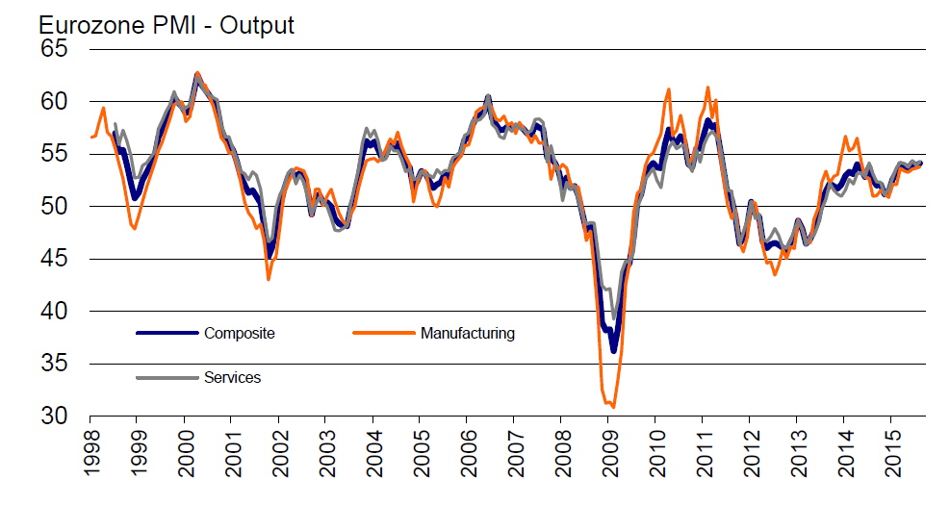
Slight Growth in Manufacturing Industry and Services in Eurozone in 2015
Purchase Managers’ Index (PMI), 50 = no change from previous month
Latest information August 2015.
Source: Markit

Slide 31
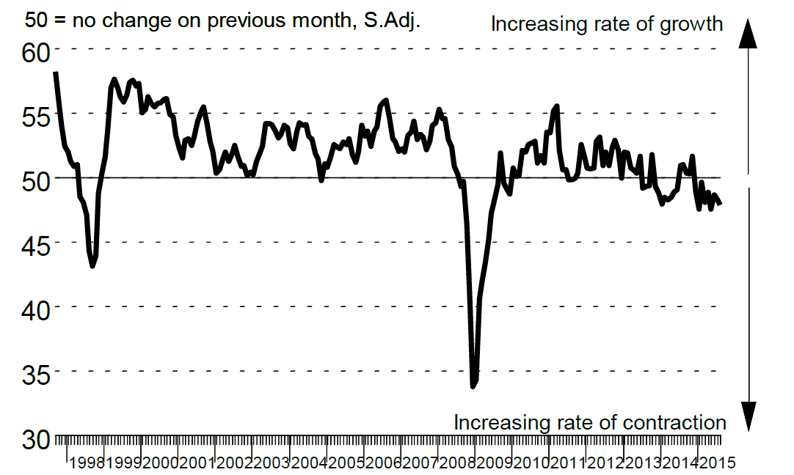
Russian Economy is in Negative Circle
Purchase Managers’ Index (PMI) in manufacturing industry in Russia
50 = no change from previous month
Latest information August 2015.
Source: Markit

Slide 32
Global Economy is Expected to Grow by 3.3% in 2015
GDP growth in 2015, %
India
China
Middle East and Africa
Average growth:
+3,3 %
Rest of Latin America
Rest of Eastern Europe
Rest of
Asia
Mexico
North America
Western Europe
Russia
Japan
Brazil
The width of the bar indicates the share of global GDP in 2014 (adjusted for purchasing power parity), %.
Source: IMF (July 2015)

Slide 33
Export Demand for Technology Industry in Finland Will Grow by 1.9% in 2015
GDP growth in 2015, %
India
China
Rest of Latin Am.
Middle East and Africa
Rest of
Asia
Rest of Eastern Europe
Average growth:
+1,9 %
Mexico
Brazil
North America
Western Europe
Japan
Russia
The width of the bar indicates the export share of technology industry from Finland in 2014, %
Source: IMF (July 2015), Board of Customs

Slide 34
Exports from EU Countries to Russia is Falling
Source: Macrobond

Slide 35
Russia’s Share of Technology Industry Exports Will Decline Again to the Level of Approximately Five Per Cent
%
*) Soviet Union up to 1991.
Source: Finnish Customs

Slide 36
Breakdown of World Industrial Production
%
Purchasing power parity adjusted shares.
Source: Maddison (Historical Statistics), IMF and ETLA

Slide 37
Industrial Production Development by Year
Source: Macrobond

Slide 38
The Big Challenge for Finland after 2008

Slide 39
Finnish Exports up to EUR 30 Billion Short of Annual Target Level
Source: Macronond, Statistics Finland / National Accounts

Slide 40
Finnish Exports Lagging Behind Competitors
Source: Macrobond, Eurostat

Slide 41
The Share of Industry in GDP in Finland 1900-2014
*) During 1900-1974 industry covers also mines, energy, water and refuse collection sectors.
Source: Statistics Finland / National Accounts

Slide 42
Finland’s Industrial Production Will not Regain the Level of 2008 with the Present Production Capacity
Finland’s production capasity has decreased over 20 %
-21 %
2008 | 2009 | 2010 | 2011 | 2012 | 2013 | 2014 | 2015
Source: Statistics Finland / National Accounts, Industrial volume index

Slide 43
Growth of Public Debt and Tax Rate Out of Control
Increased cost burden requires cuts to public sector
Source: Macrobond, Statistics Finland

Slide 44
Industrial Investments Should be Increased in 2015
Industrial fixed and R&D investments in Finland
Million euros, at current prices
Source: Statistics Finland, Confederation of Finnish Industries’
Investment Survey (June 2014)

Slide 45
Upswing of Investments Required in Finland
Index, 2005=100
Source: OECD, Economic Outlook 2015

Slide 46
Turning Point of Productivity* Development in Finland
After 2008 Finland has lost considerable volume production in electronics, forest and machinery industries**
Index, 2000=100
**) The structure of current industry does not enable the similar productivity development as during the years 2000-2008
*) Productivity is measured as real value added per hours worked. When productivity grows (the curve rises) value added grows more than hours worked.
Value added = turnover – purchasing of materials and services
Value added = labour costs + rents + depreciations + profits
Source: Statistics Finland / National Accounts

Slide 47
Unit Labour Costs at the National Economy Level
Unit labour costs = labour costs / productivity, including the influence of effective exchange rates
2005,I =100
Finland’s price and cost
competitiveness
declines
Finland’s price and cost
competitiveness
improves
2005 | 2006 | 2007 | 2008 | 2009 | 2010 | 2011 | 2012 | 2013 | 2014 | 2015
*) In the ECB Harmonised Competitiveness Index, the average effective exchange rate of each country is calculated vis-à-vis 20 to 30 main trade partners, as well as the development of unit labour costs for the total economy.
Latest information I/2015. Source: European Central Bank

Slide 48
What should be done?
Support the renewal of the industry
Taxes should support growth and investment in Finland
Support decision making in companies related to compensation and working time
No new European nor national burdens on companies, which are deteriorating the competitiveness

Slide 49
Long-Term Outlook and Challenges
Global Structural Change Set to Continue Apace
  Industrial production and services will relocate to rapidly developing economic areas
  Strong growth, large markets, cheap labour and increasing expertise will increase the attractiveness of these regions.
Competition over Skills and Raw Materials Set to Increase
  Due to an increase in retirement, the sector’s annual recruitment need in Finland will rise considerably in the coming years.
  The availability of reasonably-priced energy also threatens to become an investment bottleneck in Finland
Combating Climate Change
  A challenge as costs are set to grow faster than in competitor countries
  An opportunity for new environmental and energy technologies

Slide 50
The Federation of Finnish Technology Industries

Slide 51
The Federation’s Member Companies 2013
Number of enteprises / 1 612
Number of personnel / 186 723
1–249 employees
500–999 employees
250–499 employees
1000– employees
Source: The Federation of Finnish Technology industries

Slide 52
The Federation’s SME Member Companies 2013
Number of enterprises
/ 1 463
Number of personnel / 70 646
1–19 employees
50–99 employees
20–49 employees
100–249 employees
Source: The Federation of Finnish Technology industries

